Slide 1
Clarifying the limits of conditionality using semantic map analysis
Steve Nicolle
Canada Institute of Linguistics and SIL Global

Slide 2
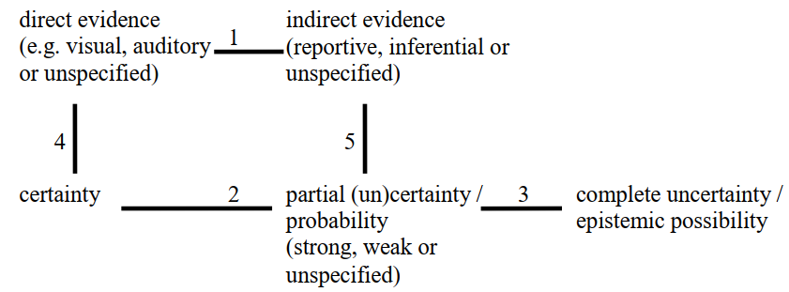
Semantic maps: epistemic expressions (Boye 2010)

Slide 3
Semantic maps: epistemic expressions (Boye 2010)
Unique ‘functions’:
uses/meanings or meaning regions (attested in at least one language by a single construction)
Notes:
‘Function’ is the term used by de Haan 2010, ‘uses’ is from van der Auwera 2013. For a function to be unique, it should be attested in at least one language by a single construction OR if A, B, and C are consistently found paired together A-B and B-C then A, B, and C are all considered functions.

Slide 4
Semantic maps: epistemic expressions (Boye 2010)
Parentheses indicate that more fine-grained meaning distinctions can be made in certain languages.

Slide 5
Semantic maps: epistemic expressions (Boye 2010)
Numbered connecting lines indicate synchronic polyfunctionality or diachronic change of an expression in at least one language.
Notes:
I will only be concerned with polyfunctionality, not with diachronic change.

Slide 6
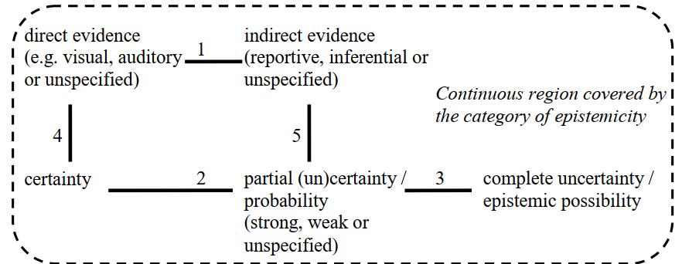
Semantic maps: epistemic expressions (Boye 2010)
Connected meanings form a cross-linguistic category or ‘domain’, e.g. epistemicity.
(However, the analyst must limit the category to a “notionally coherent” semantic space.)
Notes:
Boye (2010: 18) notes that a cross-linguistic category should be “notionally coherent”. For example, expressions of indirect evidence have developed from perfects, resultatives, and past tenses in certain languages, but “clearly, the meaning of indirect evidence is notionally distinct from its three source meanings.”

Slide 7
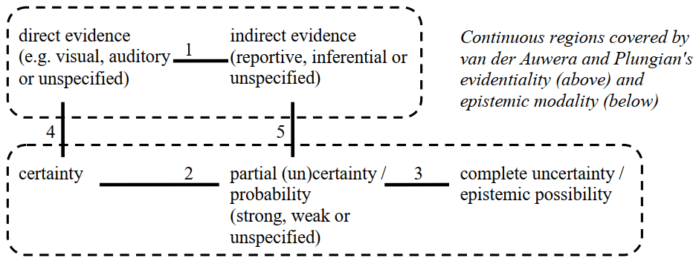
Semantic maps: epistemic expressions (Boye 2010)
It is possible – and may be desirable – to subdivide a cross-linguistic category.
Some languages may have grammaticalized expression of evidence but not of epistemic modality, or vice versa; others may have connecting lines 1, 2 and 3, but not 4 or 5.
Notes:
Although a cross-linguistic category is notionally coherent, this isn’t necessarily reflected in every language; that is, not every language will evidence every connecting line. When a significant number of languages evidence connecting line 1, but not the others (or at least not 4 and 5), the category of evidentiality will be more useful when describing and comparing those languages. However, when an influential or widely studied language evidences only part of a larger cross-linguistic category (such as English expressing epistemic modality but not evidentiality grammatically) this can obscure the larger category. Choosing to subdivide epistemicity into evidentiality and epistemic modality isn’t a matter of right or wrong, only of how useful each choice is for a particular language or group of languages.

Slide 8
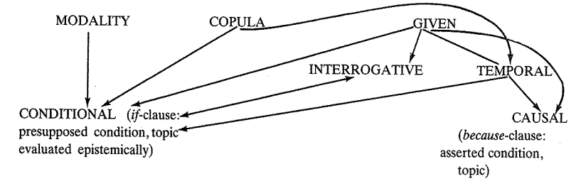
Semantic maps: Conditional and related categories
Traugott treats CONDITIONAL as a single node in the map and shows how formal markers of the protasis relate diachronically to other cognitive categories.
(Traugott 1985: 299, cited in Mao 2013: 34)

Slide 9
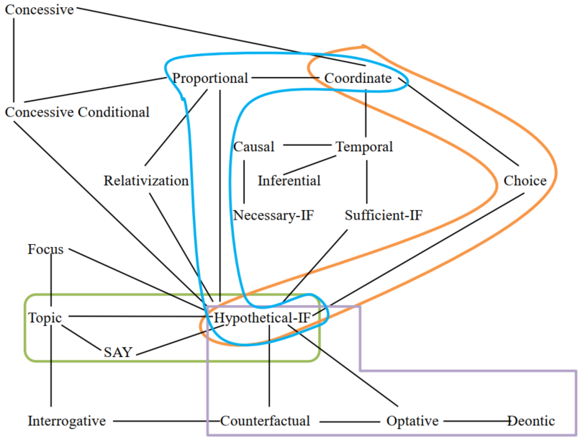
Semantic maps: Conditional and related categories
wh-correlative
Mao (2013: 166) relates conditional (Hypothetical-IF) to other categories and shows the boundaries of 4 grammatical expressions in Peking Mandarin.
yaobu(ran)
shuo
yao

Slide 10
Aims and Methodology
Focus on the internal distinctions within the semantic domain of conditionality.
Use semantic maps that show how these internal distinctions are encoded in different languages.
Data: Primarily non-European (African) languages, based on availability of descriptions.
Identify broad (non-exhaustive) typologies of conditionals and related categories.
Argue that CONDITIONAL is not a natural, pre-determined category, but is rather one among various possible comparative concepts.

Slide 11
Internal distinctions: Four classifications of conditional meanings
Thompson, Longacre & Hwang (2007) |  | Taylor (1997) | Saloné (1979) |  | Feuillet (2006)
Reality | Present | Factual | Simple |  | Réalité | Équatif
 | Habitual/ Generic |  |  |  |  | Temporel/ Causal
 | Past |  |  |  |  | Réelle
Unreality | Predictive | Hypothetical |  |  | Zone transitoire | Éventuel
 | Hypothetical |  | Imaginary | Hypothetical |  | Potentiel
 | Counterfactual | Counterfactual |  | Counterfactual | Hypothétique | L'irréalisable
 |  |  |  |  |  | L'irréalisé

Slide 12
Conditional meanings in English (adapted from Thompson, Longacre & Hwang 2007)
Factual (can be replaced by since or as)
(1) [If it’s raining out there,]_{P} [my car is getting wet.]_{Q} (present)
(2) [If you were at the party,]_{P} [then you know about Sue and Fred.]_{Q} (past)
Generic (can be replaced by when in the sense of ‘any time, whenever’)
(3) [If you step on the brake,]_{P} [the car slows down.]_{Q}
Predictive
(4) [If he gets the job,]_{P} [we’ll all celebrate.]_{Q}
Hypothetical or “Future Less Vivid” (Iatridou 2000)
(5) [If he {got / were to get} the job,]_{P} [we would all celebrate.]_{Q}
Counterfactual
[If he had got the job,]_{P} [we would have celebrated.]_{Q}

Slide 13
Conditional meanings in French (Feuillet 2006, cited in Solomiac 2017: 87)
Une zone indicative réservée à la réalité :
Équatif : si x=2, alors 2x=4 ;
Temporel, causal (si équivalent à comme, puisque, étant donné que…) : si c'est comme ça, je m'en vais ;
Protase assumée comme réelle : si tu vas en ville, rapporte-moi le journal ;
Une zone transitoire, intermédiaire entre la réalité et l'hypothétique, réservée au doute :
Éventuel : s'il fait beau, je sors ;
Potentiel : si je peux, je viendrai ;
Une zone hypothétique réservée à l'irréel et pour laquelle on peut distinguer entre :
L'irréalisable : si j'avais des ailes, je volerais ;
L'irréalisé : si j'avais su, je ne serais pas venu.

Slide 14
English
Factual if in p
Generic Predictive Hypothetical
Counterfactual
Notes:
In this single-language semantic map, the rectangle indicates the various functions of constructions containing if in the protasis. This also happens to coincide with the domain of conditionality as this is commonly understood. This is a huge oversimplification; I haven’t included epistemological conditionals, in which q is a conclusion rather than a prediction (If the light is on, she is at home), nor have I included bi-conditionals or concessive conditionals. In part this is because data about these functions is particularly hard to find, and in part I need to keep the maps simple for the purposes of a short presentation. I also haven’t yet demonstrated that each of the functions is unique, that is, expressed in at least one language by a single construction.

Slide 15
English
[ Temporal ] [ Conditional ]
since, as Factual if in p
when
any time Generic Predictive Hypothetical
specific time Counterfactual
Notes:
The rectangles around ‘since, as’ and ‘when’ indicate that these are domains in their own right. Together, these form part of a broader temporal semantic field.

Slide 16
A typology of conditionals
One of the aims of this paper is to identify a broad (non-exhaustive) typology of conditionals and related categories. As a first step, I have created maps for some languages of the following types:
Languages without dedicated conditional expressions, in which all constructions with conditional meaning also have a range of other meanings.
Languages in which conditional constructions do not express ‘factual’ conditionals.
Languages with a basic two-way distinction between O-marked and X-marked (or ‘simple’ and ‘imaginary’) conditionals.
Languages with ‘situatives’, which combine conditional and temporal meanings in a single semantic domain. (Most of these also make a basic two-way distinction.)

Slide 17
1. Languages without dedicated conditional constructions
In some languages, all constructions with conditional meanings/functions also have a range of other meanings/functions.
Makary Kotoko [mpi] (Chadic; Cameroon; Allison 2017)
“In Makary Kotoko, conditional constructions are formally indistinguishable from certain types of temporal constructions such that the evaluation of whether a construction is ‘conditional’ or ‘temporal’ in nature can only be made by an examination of the larger context.” (Allison 2017: 34)
Abawiri (Lakes Plain, Papua) has no dedicated conditional constructions. Conditional meanings are derived from other constructions, primarily a topicalized clause construction, and constructions involving irrealis markers (see next slide).

Slide 18
Abawiri [flh] (Lakes Plain; Papua, Indonesia; Yoder 2020)
Generic
conditional
Future
‘Irrealis 2’ /^{L}H/
+ Non-past -rō
in p
Hypothetical Hypothetical
conditional main clause
‘Irrealis 2’ /^{L}H/ +
Emphatic -ō in p
Predictive
Sequential
Simultaneous
‘Topic’ bo in p
Counterfactual
Incompletive + ‘Irrealis 1’ -rē + Non-future -ri in q

Slide 19
2. Languages without ‘factual’ conditionals
In some languages, if the speaker knows that p is true, then a conditional construction cannot be used.
(1) [If it’s raining out there,]_{P} [my car is getting wet.]_{Q} (present)
(2) [If you were at the party,]_{P} [then you know about Sue and Fred.]_{Q} (past)
These languages may be common, but data is absent in many published descriptions. Absence of evidence ≠ evidence of absence.
One language for which data is available is Gumuz.

Slide 20
Gumuz [guk] (Nilo-Saharan; Ethiopia; Williamson & Larson 2017)
Generic
[k-aa-bas’ a-dama maca]_{P} [ça-da a-p-aaŋgo]_{Q}
cond-nfut-leave.behind nom-rain rain.inf seed-thing nfut-sprout-neg
‘If it does not rain, seeds do not sprout.’
Predictive
[k-aa-bas’ a-dama maca]_{P} [ça-da ala-m a-p-aaŋgo]_{Q}
cond-nfut-leave.behind nom-rain rain.inf seed-thing gen-1sg.poss nfut-sprout-neg
‘If it does not rain, my seeds will not sprout.’
Counterfactual
[k-aa-mah-oo-ç a-daa-It'op'eya Naaigiriya]_{P} [d-ek-uw-aatish]_{Q}
cond-nfut-defeat-pl-cl:eye nom-people-Ethiopia Nigeria aff-hyp-3pl.nfut-pass
‘If the Ethiopians had defeated Nigeria, they would have advanced (to the World Cup).’

Slide 21
Gumuz [guk] (Nilo-Saharan, Ethiopia; Williamson & Larson 2017)
Hypothetical
[k-aa-wot ee-d-aa-wot-an-aam na-gu-mila]_{P} [d-e-gam-ash-izh-aam]_{Q}
cond-nfut-be like-aff-nfut-be-loc-2sg loc-place-1pl.excl aff-fut-know-cl:hip-prf-2sg
‘If you were with us yesterday, you will have learned it.’ (e- = possibility, not future)
Factual
[nagw-aa-wot-aam na-gu-mila]_{P} [d-aa-gam-ash-izh-aam]_{Q}
temp-nfut-be-2sg loc-place-1pl.excl aff-nfut-know-cl:hip-prf-2sg
‘Since you were with us, you have learned it.’ (p is known to be true; *k-)
Compare:
nagw-aa-w-e n-ila-magaakwa, [k-aa-s'iy-aawaaça a-k'os-uwa]_{P} ….
temp-nfut-come-twrd loc-belly-night, cond-nfut-break-conj nom-teeth-2sg.poss
‘When you come in the night time, if you (fall) and break your teeth …’

Slide 22
Gumuz [guk] (Nilo-Saharan, Ethiopia; Williamson & Larson 2017)
[ Temporal ] [ Conditional ]
nagw
‘since’ k-aa- Cond. + Non-Future in p
factual ‘cond.’
Generic Predictive Hypothetical
‘when’
specific time
Counterfactual
‘whenever’
any time

Slide 23
3. Languages with a basic two-way distinction
Thompson, Longacre & Hwang (2007) |  | Taylor (1997) | Saloné (1979) |  | Feuillet (2006)
Reality | Present | Factual | Simple |  | Réalité | Équatif
 | Habitual/ Generic |  |  |  |  | Temporel/ Causal
 | Past |  |  |  |  | Réelle
Unreality | Predictive | Hypothetical |  |  | Zone transitoire | Éventuel
 | Hypothetical |  | Imaginary | Hypothetical |  | Potentiel
 | Counterfactual | Counterfactual |  | Counterfactual | Hypothétique | L'irréalisable
 |  |  |  |  |  | L'irréalisé

Slide 24
Hypothetical and counterfactual conditionals in English can be expressed through past tense shifting or subject-auxiliary inversion in p, and would in q:
Hypothetical
(5) [If he {got / were to get} the job,]_{P} [we would all celebrate.]_{Q}
(5’) [Were he to get the job,]_{P} [we would all celebrate.]_{Q}
Counterfactual
(6) [If he had got the job,]_{P} [we would have celebrated.]_{Q}
(6’) [Had he got the job,]_{P} [we would have celebrated.]_{Q}
Following von Fintel & Iatridou (2023) these are “X-marked” conditionals, as opposed to “O-marked” conditionals (where O = open/ordinary).

Slide 25
English
Factual if in p + past tense shifting in p
+ would in q
Generic Predictive Hypothetical
Counterfactual
or: past tense shifting +
sub./aux. inversion in p
+ would in q

Slide 26
Haya [hay] (Bantu; Tanzania; Saloné 1979)
Factual
[ká John a-la-ba y-á-ikiriza]_{P} [Jack y-á-yânga]_{Q}
cond John 3sg-fut-aux 3sg-pst1-agree Jack 3sg-pst1-disagree
‘If John agreed, Jack disagreed (earlier today).’ (Saloné 1979: 68)
Predictive
[ká n-da-mu-bóna]_{P} [n-da-mu-gambîla]_{Q}
cond 1sg-fut-3sg-see 1sg-fut-3sg-tell
‘If I see him, I will tell him.’ (Saloné 1979: 70)

Slide 27
Haya [hay] (Bantu; Tanzania; Saloné 1979)
Hypothetical
[ká n-a-ku-bona éfarasy’ ein’ ámabába]_{P} [ti-n-á-ku-amini]_{Q}
cond 1sg-pst1-unreal-see horse having wings neg-1sg-pst1-unreal-believe
‘If I saw a horse with wings, I wouldn’t believe it.’ (Saloné 1979: 75)
Counterfactual
[ká n-a-ku-g-ile omúká]_{P} [n-á-ku-l-ile ébitooke n-énfulú]_{Q}
cond 1sg-pst1-unreal-go-pst2 home 1sg-pst1-unreal-eat-pst2 bananas and-fish
‘If I had gone home, I would have eaten bananas and fish.’ (ibid.)

Slide 28
Haya [hay] (Bantu; Tanzania; Saloné 1979)
[ ‘Simple’ (O-marked) ] [ ‘Imaginary’ (X-marked) ]
Factual ká in p a-ku- Past1+Unreal
in p and q
Generic Predictive Hypothetical
la- Near Future’
in p Counterfactual
Notes:
This is the basis of Saloné’s distinction between ‘Simple’ conditionals (consisting of Factual, Generic, and Predictive (which she calls ‘future simple’) and ‘Imaginary’ conditionals.

Slide 29
Tamazight [tzm] (Berber, Afro-Asiatic; Morocco; Ech-Charfi 2024)
Predictive (Factual and Generic have the same form)
[xm i-wwəƟ unz^{ʕ}ar^{ʕ} asəkka]_{P} [ðað i-qqim g uxam]_{Q}
cond 3ms-hit.per rain tomorrow fut 3ms-stay in home
‘If it rains tomorrow, he will stay home.’
Hypothetical / Counterfactual
[mus ðað j-awð^{ʕ} asəkka]_{P} [uma gguni-x-Ɵ]_{Q}
cond fut 3ms-arrive tomorrow part wait.per-1sg-him
‘If he arrives tomorrow, I would wait for him.’
[murid i nta]_{P} [uma iwð^{ʕ}ə-x zik]_{Q}
cond.neg part 3ms part arrive.per-1sg early
‘Were it not for him, I would have arrived early.’

Slide 30
Tamazight [tzm] (Berber, Afro-Asiatic; Morocco; Ech-Charfi 2024)
[ ‘Simple’ (O-marked) ] [ ‘Imaginary’ (X-marked) ]
Factual mus ‘if’ + Perfect /
murid ‘if not’ in p,
uma in q
Generic Predictive Hypothetical
xm ‘if’ + Perfect in p
Counterfactual
Tamazight has a separate expression adday ‘when, whenever’ which can be used in place of xm when the situation in p is more certain.

Slide 31
Nafsan [erk] (Oceanic; Vanuatu; Krajinović 2018)
Nafsan is an outlier, with hypothetical conditionals expressed differently:
Factual =fla’ in p
Generic Predictive Hypothetical
=f in p
Counterfactual

Slide 32
4. Languages with ‘situative’
The term ‘situative’ (from Doke 1935) describes constructions in which the relation between p and q can be either primarily conditional (p causes q, p is evidence for q etc.), or temporal (p occurs before or at the same time as q), or both. The appropriate interpretation depends on context and/or other grammatical markers, rather than being encoded by the situative marker.
“Many languages, from all over the world, use the same marker for ‘when’ (Temporal linking) and ‘if’ (Conditional linking). … Which kind of linking is involved has, in some languages, to be inferred from the semantics and pragmatics of the discourse in which the linking appears.” (Dixon 2009: 14)
Languages with situatives typically also have distinct ‘imaginary’ or ‘X-marked’ (hypothetical and counterfactual) conditionals.

Slide 33
4. Languages with ‘situative’
“It is most common in European languages to find a morphological difference drawn between conditional clauses introduced by if (English) or si (French) and temporal clauses introduced by when (English) or quand (French). Then the TAM in the conditional clause may introduce a further difference between the potential and irrealis readings of the conditional... The situation is different in the African languages studied here [which are from the Chadic family]. In Hausa for example, the conditionals introduced by in ‘if’ can have both a temporal and a potential reading but cannot have an irrealis reading.” (Caron 2006: 71)

Slide 34
Languages with ‘situative’
Hausa
Situative
[in za: kà hu:tà:,]_{P} [kà zaunà: nân ]_{Q}
sit fut 2sg rest 2sg sit here
‘If you want to rest, sit here.’ (Caron 2006: 71)
[in mun gamà cî-n àbinci,]_{P} [sai mù fita ya:wò: ]_{Q}
sit 1pl.perf finish eat-gen food then 1pl go_out stroll
‘When we have finished eating, we’ll go for a walk.’ (ibid.)
Counterfactual
[dà: sun tàimàke: mù,]_{P} [dà: mun gamà:]_{Q}
irr 3per help 1pl irr 1pl.per finish
‘If they had helped us, we would have finished.’ (ibid.)

Slide 35
Tuwuli [bov] (Kwa; Ghana; Harley 2017)
Situative (generic)
[ntɛ ɔ-mɔ lɔfɔã ni,]_{P} [d-e kanɛ liti deĩ tigigli]_{Q}
cond 2sg-see tortoise link agr-it back behind have sections
‘If/Whenever you see tortoise, his back is all patched.’ (Harley 2017: 125)
Situative (predictive)
[ntɛ ɛ-ya]_{P} [bɔ-aa-via ye fo-e akũ fɔlɛtsa]_{Q}
cond 3sg-come 1pl-fut-ask 3sg.obj ref-it on matter
‘If/When he comes, we will ask him about it.’ (ibid.)

Slide 36
Tuwuli [bov] (Kwa; Ghana; Harley 2017)
Hypothetical
[ntɛ aa-ya,]_{P} [kufɛ fɔ-nɛnɛ]_{Q}
cond 2sg.fut-come irr 3sg.ref-be:good
‘If only [#When] you were to come, it would be good.’ (Harley 2017: 127)
Counterfactual
[ntɛ ɔ-nya fu-kĩĩ,]_{P} [kufɛ o-ku]_{Q}
cond 2sg-eat ref-dem irr 2sg-die
‘If [#When] you had eaten this, you would have died.’ (ibid.)
“The basic function of kufɛ is to indicate that there is something misleading, unrealised, or unfulfilled about the information given.” (Harley 2017: 127)

Slide 37
Tuwuli [bov] (Kwa; Ghana; Harley 2017)
ntɛ Situative in p kufɛ Irrealis in q
Generic Predictive Hypothetical
‘whenever’ ‘when’ Counterfactual
(any time) (specific time)

Slide 38
Opo [lgn] (Nilo-Saharan; Ethiopia; Josh Smolders p.c.)
Generic
[mʊ́ ʊ̀tʼɪ́ a-sá kám=ɪ́nɪ̄]_{P} [dʒo᷅ː a-po᷄ːtʰá-ēs]_{Q}
rel fire ipfv-eat.sg place=dem.med snake ipfv-leave.pl:dd3-body
‘If/Whenever fire burns there, the snakes flee.’
Predictive
[mʊ́ āɡā=á-kàm dʒo᷅ː]_{P} [āɡā=á-kʼósó=ān]_{Q}
rel 1sg=irr-find snake 1sg=irr-kill.sg=3nh
‘If/When I find a snake, I will kill it.’

Slide 39
Opo [lgn] (Nilo-Saharan; Ethiopia; Josh Smolders p.c.)
Hypothetical (but strong expectation of q if p should occur)
[mʊ́ āɡā=á-sɪ́ná kàm dʒo᷅ː]_{P} [āɡā=á-kʼósó=ān]_{Q}
rel 1sg=irr-hypth find snake 1sg=irr-kill.sg=3nh
‘Should I find a snake, I will kill it.’ (*‘When I find a snake, …)
Hypothetical / Counterfactual
[mʊ́ ʊ̀tʼɪ́ á-sɪ́ná sá kám=ɪ́nɪ̄]_{P} [dʒo᷅ː á-sɪ́ná po᷄ːtʰá-ēs]_{Q}
rel fire irr-hypth eat.sg place=dem.med snake irr-hypth leave.pl:dd3-body
‘If the fire burned there, the snakes would have fled.’ (past hypothetical)
‘If the fire is burning there, the snakes will have fled.’ (present hypothetical)
‘If the fire will burn there, the snakes will flee.’ (future hypothetical)
‘Had the fire burned there, the snakes would have fled.’ (counterfactual)

Slide 40
Opo [lgn] (Nilo-Saharan; Ethiopia; Josh Smolders p.c.)
mʊ́ REL in p
+IPFV in p & q +IRR in p & q
Generic Predictive
‘whenever’ ‘when’
(any time) (specific time)
+IRR +síná HYPTH
in p & q
Hypothetical
Counterfactual

Slide 41
Languages with separate ‘situative’ and O-marked conditional
Some Bantu languages have three categories of ‘conditional’ marking:
a situative marked with a verbal prefix in p;
an O-marked (Simple) conditional marker consisting of a subordinating conjunction in p;
an X-marked (Imaginary) conditional marked with verbal prefixes in both p and q.
In Cuwabo and Swahili, as well as in a number of other Bantu languages, the subordinating conjunction originates from the situative form of a verb meaning ‘be, stay, live’. However, it is not used to express the temporal relations that the situative marker expresses.

Slide 42
Cuwabo [chw] (Bantu; Mozambique; Guérois 2017)
Situative: a- or gaa- (interchangeable)
[mu-a-segedh-éya]_{P} [[dhi-ní-funá=inyu]_{REL} ka-dh-él-aga=ni]_{Q}
2pl-sit-cause.trouble-neuter sm10-ipfv.cj-want= pro2pl imp-go-appl-hab=pl
‘Whenever/If you are in trouble, anything you want, come and collect.’
[mu-gaa-ddí-kos-él ma-bása=ene ábo]_{P} [[e-ní-funá=inyu]_{REL} ka-lóga=ni]_{Q}
2pl-sit-1sg-do-appl 6-work=int 6.dem.ii sm9-ipfv.cj-want= pro2pl imp-say=pl
‘When/If you achieve that task for me, tell whatever you want.’ (Guérois 2017: 195)

Slide 43
Cuwabo [chw] (Bantu; Mozambique; Guérois 2017)
O-marked (Simple) conditional: akala < a-kala sit-be
[akala ddi míyo=ene]_{P} [ó-salu óbu o-patúw-el-e mu-íko]_{Q}
if cop pro1sg=int 14-thread 14.dem.i sm14-break-appl-sbj 18-river
‘If it is me, may this thread break (in direction) to the river.’ (Guérois 2017: 204)
Hypothetical / Counterfactual: ka-o- in p, gaa- in q
[ka-o-ibá yaddíddi]_{P} [ddi-gaa-hí-lala yamumélo]_{Q}
cf-inf-sing much 1sg-hyp-pfv.dj-weaken voice
‘If I sang a lot, I would damage my voice.’
‘If I had sung a lot, I would have damaged my voice.’ (Guérois 2017: 205)

Slide 44
Cuwabo [chw] (Bantu; Mozambique; Guérois 2017)
akala ‘if, whether’ in p
ka-o- CF+INF in p,
gaa- HYP in q
Generic Predictive
Hypothetical
‘whenever’ ‘when’
(any time) (specific time) Counterfactual
a- / gaa- Situative in p

Slide 45
Swahili [swa] (Bantu; East Africa; Mwamzandi 2017, Saloné 1983a, b)
ki- Situative: verbal prefix in p
Usually temporal, predictive, or hypothetical with high or neutral probability. Occasionally factual or generic.
[Ni-ki-mw-ona]_{P} [ni-ta-mw-ambia]_{Q} [Ni-ki-mw-ona]_{P} [ni-li-shangaa]_{Q}
1sg-ki-3sg-see 1sg-fut-3sg-tell 1sg-ki-3sg-see 1sg-pst-be_surprised
‘If/When I see her/him, I will tell her/him.’ ‘Seeing her/him, I was surprised.’
(Saloné 1983b: 38)
A conditional interpretation is only possible with ki- when p precedes q.
[Ni-li-mw-ona simba]_{Q} [a-ki-nyemelea banda la ng’ombe]_{P}
1sg-pst-3sg-see lion 3sg-ki-move_towards shed of cows
‘I saw the lion moving stealthily toward the cow stable.’
*’I saw the lion if he moved…’ (Saloné 1983b: 41)

Slide 46
Swahili [swa] (Bantu; East Africa; Mwamzandi 2017, Saloné 1983a, b)
Ikiwa Subordinating conjunction in p (i- inanimate sg. subject + ki- + wa ‘be’)
Usually indicates predictive or hypothetical conditionals with high or neutral probability. Occasionally indicates factual or generic conditionals. P and q can be in either order.
No temporal usage.
[Polisi i-ta-m-kamata]_{Q} [ikiwa a-ta-endesha shughuli za kisiasa]_{P}
9.police cl9-fut-3sg-arrest if 3sg-fut-conduct activities of political
‘The police will arrest him, if (*when) he conducts political activities...’
(adapted from Mwamzandi 2017: 168)

Slide 47
Swahili
Differences between verbal prefix ki- and subordinating conjunction ikiwa
Because ki‑ occurs in the TAM slot before the verb, when the verb in p is marked for tense or aspect ikiwa must be used.
Ikiwa is used predominantly when the subjects of p and q are different, whilst ki‑ is mostly used when the subject is the same in both clauses.
Often, ikiwa occurs when q could function as the answer to a polar question: “Ikiwa the child meets the requirements for financial aid, then we will help him” answers the presupposed question “Will your organization help the boy to pay his school fees?”
In contrast, ki- in p can answer a ‘when’ question: “When does a cow lick her calf?”
[ng’ombe a-ki-zaa ndama]_{P} [hu-m-lamba]_{Q}
cow 3sg-ki-give_birth_to calf hab-3sg.obj-lick
‘When a cow gives birth to a calf, she licks it.’
“When can you help me?” [Ni-ki-rudi]_{P} [ni-ta-weza ku-ku-saidia]_{Q}
1sg-ki-return 1sg-fut-be_able inf-2sg.obj-help
‘When I return, I will be able to help you.’

Slide 48
Swahili [swa] (Bantu; East Africa; Mwamzandi 2017, Saloné 1983a, b)
nge- Verbal prefix in p and q; indicates hypothetical and counterfactual conditionals in which the probability of p is low or impossible.
ngali- Verbal prefix in p and q; indicates counterfactual conditionals.
[Mungu a-nge-m-jalia]_{P} [a-nge-nunua kinu chake mwenyewe]_{Q}
God 3sg-nge-3sg-bless 3sg-nge-buy mortar hers her_own
‘If God were to bless her, she would buy her own mortar.’ (Saloné 1983b: 65-66)
[Ni-nge-jua]_{P} [ni-si-nge-kuja]_{Q}
1sg-nge-know 1sg-neg-nge-come
‘If I had known, I would not have come.’ (Mwamzandi 2017: 160)
[Ni-ngeli-kuwa na nia mbaya]_{P} [si-ngeli-m-wekea hata sumu?]_{Q}
1sg-ngeli-be with intention bad neg-ngeli-3sg-put_in even poison
‘If my intentions were bad, wouldn’t I have poisoned him.’ (ibid.)

Slide 49
Swahili [swa] (Bantu; East Africa; Mwamzandi 2017, Saloné 1983a, b)
Kama Subordinating conjunction in p
Used alone it usually indicates factual or generic conditions or reason.
Used in conjunction with verbal prefixes kama indicates which clause is p (subordinate) especially with nge- and ngali- (which occur in both p and q) and when q precedes p.
[Kama kengele i-na-lia]_{P} [basi ni saa sita]_{Q}
kama 9bell cl9-pres-cry then cop hour six
‘If the bell is ringing, then it’s 12 o’clock.’ (Saloné 1983b: 23) [factual / generic]
When kama co-occurs with ki-, only a conditional interpretation is possible.
[Kama Maria a-ki-ja]_{P} [ni-ta-mw-ona]_{Q}
kama Maria 3sg-ki-come 1sg-fut-3sg-see
‘If (*When) Maria comes, I will see her.’ (based on Saloné 1983b: 23)

Slide 50
Swahili [swa] (Bantu; East Africa)
Factual ikiwa
kama nge-
Generic Predictive Hypothetical Hypothetical
(likely/neutral) (unlikely)
‘whenever’ ‘when’ ki- Counterfactual
(any time) (specific time)
ngali-
‘while’ (simultaneous time)

Slide 51
Is ‘conditional’ a cross-linguistic generic category?
Cross-linguistic generic categories need not be instantiated in every language, but are widely attested, notionally coherent semantic categories, such as TAME categories. As such, they can be viewed as “natural kinds”.
Variation in the expression of conditionality suggests that ‘conditional’ might be better understood as one among a few related cross-linguistic comparative concepts.
Comparative concepts:
are “concepts specifically designed for the purpose of comparison that are independent of descriptive categories.” (Haspelmath 2010: 664)
“cannot be right or wrong. They can only be more or less well suited to the task of permitting crosslinguistic comparison.” (Haspelmath 2010: 665)
“are not natural kinds, because they do not recur across languages with identical properties.” (Haspelmath 2018: 109)

Slide 52
Conditional template
Factual
Generic Predictive Hypothetical
Marked in p Counterfactual

Slide 53
Simple Conditional + Imaginary/X-marked Conditional
Factual
SIMPLE / O-MARKED IMAGINARY / X-MARKED
Generic Predictive Hypothetical
Marked in p Counterfactual
Marked in p Marked in p and q
Notes:
This is the basis of Saloné’s distinction between ‘Simple’ conditionals (consisting of Factual, Generic, and Predictive (which she calls ‘future simple’) and ‘Imaginary’ conditionals.

Slide 54
Situative + Imaginary/X-marked Conditional
Factual
SITUATIVE IMAGINARY / X-MARKED
Generic Predictive Hypothetical
‘whenever’ ‘when’ Counterfactual
(any time) (specific time)
Marked in p Marked in p and q
Marked in p
Notes:
This is the basis of Saloné’s distinction between ‘Simple’ conditionals (consisting of Factual, Generic, and Predictive (which she calls ‘future simple’) and ‘Imaginary’ conditionals.

Slide 55
Korean [kor] (Sohn 2009; Yeom 2004)
The suffix “-(u)myen may refer to both ‘if’ and ‘when’ if not occurring with the modal adverb manil ‘by any chance’ in which case only the conditional meaning is possible.” (Sohn 2009: 303)
Another suffix –ketun is only used as a conditional, but q must indicate the speaker’s intention.
[pi ka o-myen; *-ketun]_{P} [Mia nun aph-ayo]_{Q}
rain sbj come-if/when -if Mia top sick-pol
‘If/When it rains, Mia gets sick.’ (Sohn 2009: 305)
Sohn, Ho-Min. 2009. The semantics of clause linking in Korean. In R. M. W. Dixon & Alexandra Y. Aikhenvald (eds.) The semantics of clause linking: A cross-linguistic typology, 285–317. Oxford: Oxford University Press.
Yeom, Jae-Il. 2004. Comparison of two conditional connectives –(u)myen and –ta/la-myen in Korean. Language and Information 8(1): 137–161.

Slide 56
Japanese
Salanciová 2023 dspace.cuni.cz #130371144
chrome-extension://efaidnbmnnnibpcajpcglclefindmkaj/https://dspace.cuni.cz/bitstream/handle/20.500.11956/186560/130371144.pdf?sequence=1&isAllowed=y
Takubo 2020 https://www.researchgate.net/publication/332249939_Conditionals_in_Japanese_in_Handbook_of_Japanese_Semantics_and_Pragmatics_Ed_by_Wesley_Jacobsen_Harvard_U_and_Yukinori_Takubo_NINJAL
Yang 2022 chrome-extension://efaidnbmnnnibpcajpcglclefindmkaj/https://par.nsf.gov/servlets/purl/10350235

Slide 57
Appendix: Japanese
Leaving aside the optional adverb moshi in p (Yang 2022), Japanese has four primary markers of conditionality: suffixes -reba and -tara, and clitics nara and to.
Masuoka (1993) proposes prototypical uses for each marker:
-reba general causal relation
-tara temporal dependency
nara the situation in p is true; q expresses the speaker’s judgment/attitude about p
to “typically does not express a hypothetical or unreal situation, but it rather depicts a situation usually observed in reality”
(Masuoka 1993: 14, cited in Salanciová 2023: 29)

Slide 58
Japanese (Takubo 2020)
Factual (all except to)
Context: I see Taro’s car in the parking lot.
[Taroo ga {ki-te iru nara / i-tara / i-reba / #to}]_{P} …
Taro nom come-res npst nara / tara / reba / to
‘If Taro is already here …’
-tara and -(r)eba can’t be used if the information in p comes from another person rather than, say, a schedule or the speaker’s observation:
Context: John has told me that Taro is here.
[Taroo ga {ki-te iru nara / #i-tara / #i-reba}]_{P} …
Taro nom come-res npst nara / tara / reba
‘If Taro is already here …’ (Takubo 2020: 470)

Slide 59
Japanese (Takubo 2020)
Generic (all except nara)
[En ga agar-u {-tara / -reba / *nara / to}]_{P} keiki ga warukunar-u]_{Q}
Yen nom rise-npst tara / reba / nara / to economy nom become.bad-npst
‘If the yen rises, the economy slows down.’ (based on Takubo 2020: 483)
Temporal (-tara and to only)
[Ano toki koohii o {non-dara / *nom-eba / *nom-u nara / nom-u to}]_{P}
that time coffee acc drink-tara / drink-reba / drink-npst nara / drink-npst to
[yoru nemur-e-naku nat-ta]_{Q}
night sleep-pot-neg.inf become-pst
‘When I drank coffee at that time, I would not be able to sleep at night.’ (ibid. 466)

Slide 60
Japanese (Takubo 2020)
Predictive (all 4)
[Keiki ga kaihuku {si-tara / su-reba / su-ru nara / su-ru to}]_{P}
Taro nom recover do-tara / do-reba / do-npst nara / do-npst to
[kozin syoohi wa nobi-ru daroo]_{Q}
individual spending top increase- npst tentative
‘If the economy recovers, individual consumption will undoubtedly increase.’
Counterfactual (all except nara)
[Keiki ga kaihuku {si-tara / su-reba / *su-ru nara / su-ru to}]_{P}
Taro nom recover do-tara / do-reba / do-npst nara / do-npst to
[kozin syoohi wa nobi-ta daroo]_{Q}
individual spending top increase- pst tentative
‘If the economy had recovered, individual consumption would have increased.’
(based on Takubo 2020: 467)

Slide 61
Japanese: -reba (general causal relation)
Factual -reba
Generic Predictive Hypothetical
Counterfactual
Temporal
(‘when’)

Slide 62
Japanese: -tara (temporal dependency)
Factual
Generic Predictive Hypothetical
Counterfactual
Temporal -tara
(‘when’)

Slide 63
Japanese: nara (the situation in p is true)
Factual
nara
Generic Predictive Hypothetical
Counterfactual
Temporal
(‘when’)

Slide 64
Japanese: to (a situation usually observed in reality)
Factual
Generic Predictive Hypothetical ??
to Counterfactual ??
Temporal
(‘when’)

Slide 65
Japanese
Factual -reba
nara
Generic Predictive Hypothetical
to Counterfactual
Temporal -tara
(‘when’)

Slide 66
References
Allison, Sean. 2017. Conditional constructions in Makary Kotoko. Studies in African Linguistics 46: 33–49.
Boye, Kasper. 2010. Semantic maps and the identification of cross-linguistic generic categories: Evidentiality and its relation to epistemic modality. Linguistic Discovery 8.1: 4–22.
Caron, Bernard. 2006. Condition, topic and focus in African languages: Why conditionals are not topics. ZAS Papers in Linguistics 46: 69–82.
Dixon, R. M. W. 2009. The semantics of clause linking in typological perspective. In R. M. W. Dixon & Alexandra Y. Aikhenvald (eds.) The semantics of clause linking: A cross-linguistic typology, 1–55. Oxford: Oxford University Press.
Doke, Clement M. 1935. Bantu linguistic terminology. New York & London: Longmans, Green.
Ech-Charfi, Ahmed. 2024. Conditionals in Berber. In Alireza Korangy & Karim Bensoukas (eds.), The Handbook of Berber Linguistics, 425–441. Singapore: Springer. http://dx.doi.org/10.1007/978-981-99-5690-6_19
Feuillet, Jack. 2006. Introduction à la typologie linguistique. Paris: Honoré Champion.
Harley, Matthew W. 2017. Conditionals in Tuwuli. Studies in African Linguistics 46: 121–141.
Haspelmath, Martin. 2010. Comparative concepts and descriptive categories in cross-linguistic studies. Language 86(3): 663–687.
Haspelmath, Martin. 2018. How comparative concepts and descriptive linguistic categories are different. In: Daniël Van Olmen, Tanja Mortelmans & Frank Brisard (eds.) Aspects of linguistic variation, De Gruyter Mouton, 83–113.
Iatridou, Sabine. 2000. The grammatical ingredients of counterfactuality. Linguistic Inquiry 31(2): 231–270.
Mao, Sheng. 2013. A functional approach to conditionals in Peking Mandarin. PhD thesis, The Hong Kong University of Science and Technology.
Masuoka, Takashi. 1993. Nihongo no jōkenhyōgen. Tokyo: Kurosio.
Mwamzandi, Mohamed. 2017. A corpus study of Swahili conditionals. Studies in African Linguistics 46: 157–173.
Salanciová, Annamária. 2023. Japanese conditional constructions. BA thesis. Charles University, Prague.

Slide 67
Saloné, Sukari. 1979. Typology of conditionals and conditionals in Haya. Studies in African Linguistics 10: 65–80.
Saloné, Sukari. 1983a. The pragmatics of reality and unreality conditional sentences in Swahili. Journal of Pragmatics 7(3): 311–324. https://doi.org/10.1016/0378-2166(83)90017-6
Saloné, Sukari. 1983b. Conditional sentences in Swahili. Los Angeles: UCLA PhD dissertation.
Solomiac, Paul. 2017. Le conditionnel en dzùùngoo de Samogohiri. Studies in African Linguistics 46: 86–99.
Takubo, Yukinori. 2020. Conditionals in Japanese. In Wesley M. Jacobsen & Yukinori Takubo (eds.) Handbook of Japanese semantics and pragmatics, 451-493. Berlin: De Gruyter Mouton.
Taylor, John R. 1997. Conditionals and polarity. In Angeliki Athanasiadou & René Dirven (eds.) On conditionals again, 289–306. Amsterdam: John Benjamins.
Thompson, Sandra A., Robert E. Longacre & Shin Ja J. Hwang. 2007. Adverbial clauses. In T. Shopen (ed.) Language typology and syntactic description, vol.2: Complex constructions (2nd edition), 237–300. Cambridge: Cambridge University Press.
Traugott, Elizabeth C. 1985. Conditional markers. In John Haiman (ed.), Iconicity in syntax, 289–307. Amsterdam: John Benjamins.
van der Auwera, Johan & Vladimir Plungian. 1998. Modality’s semantic map. Linguistic Typology 2: 79–124.
von Fintel, Kai & Sabine Iatridou. 2013. Prolegomena to a theory of X-marking. Linguistics and Philosophy 46: 1467–1510.
Williamson, Travis & Eric Larson. 2017. The form and function of conditional constructions in the Gumuz language of Metekel Zone. Studies in African Linguistics 46: 67–84.
Yoder, Brendon E. 2020. A grammar of Abawiri, a Lakes Plain language of Papua, Indonesia. PhD dissertation, University of California, Santa Barbara.
Yang, Muyi. 2022. Iffy discourse: Japanese moshi in conditionals and nominal topics. Linguistics Vanguard 2022. DOI 10.1515/lingvan-2021-0034

