Slide 1
Elaborative Discourse Markers in Georgian Conditional Constructions
Khatia Buskivadze
PhD student, Charles University
Conditional Constructs Across World Languages
INALCO, 2025

Slide 2
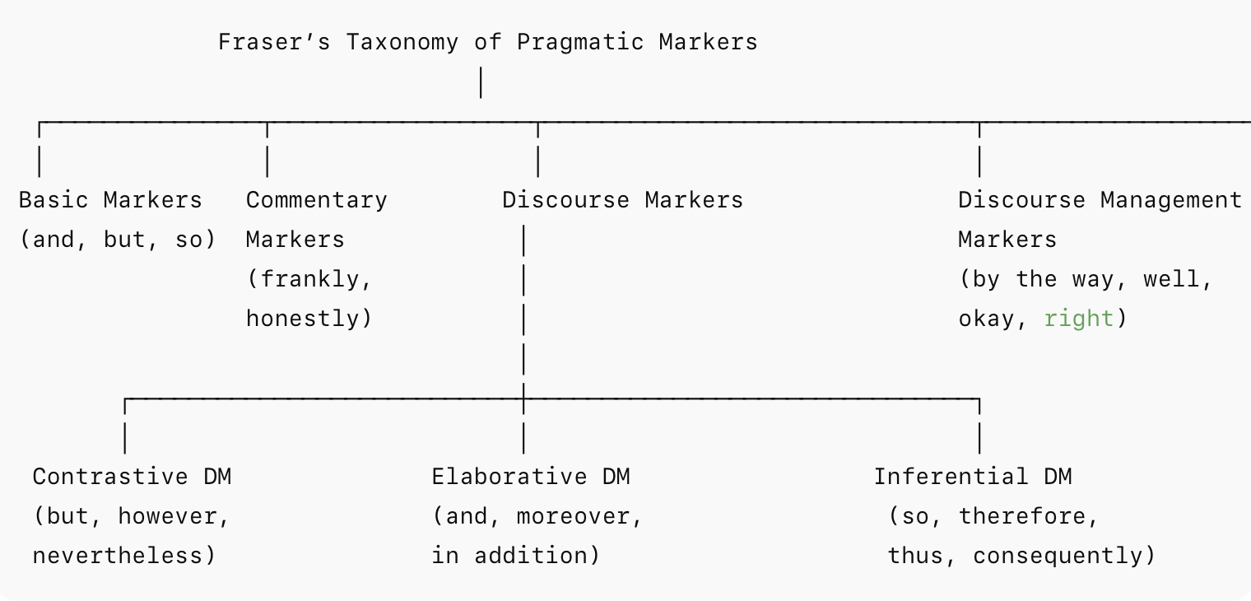

Slide 3
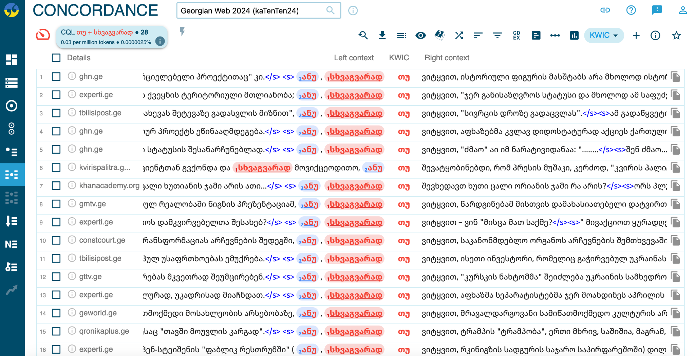
sketchengine.eu
Tu

Slide 4
EDMs with similar meanings
მსგავსად მაგისა
msgavs-ad mag-is-a
similar-ADV that.GEN
‘Similar to that’
იგივენაირად
Igive-nair-ad
similar-ADV that.GEN
‘Similarly, by the same token’
ტოლად, იდენტურად
Tol-ad, identur-ad
Equal-ADV, identical-ADV
‘Similarly, equally, identically’
მსგავსად, ასევე
Msgavs-ad, aseve
similar-AD,
‘Likewise’, ‘also’
ანალოგიურად
Analogi-ur-ad
Analogy-ADJ-ADV
‘similarly, analogously’

Slide 5
Discourse Markers
Terminology and definitions (follow the approaches- Schiffrin (1987), Fraser (1996), Schourup (1999), Jucker and Ziv (1998), Blakemore (2002), Muller (2005), Fraser (2015)
Different approaches to DMs (Halliday and Hassan, Deborah Schiffin, Bruce Fraser, Diana Blakemore)
Properties and characteristics (syntactic properties, semantic relations (4 sub-categories), prosody and its pragmatic uses) 4.
discourse and pragmatic functions (approaches to DMs)
Bruce Fraser's taxonomy of DMs —> Elaborative DMs

Slide 6
What are DMs?
“Sequentially dependent elements which bracket units of talk” (Schiffrin, 1987: 40)
Expressions indicate the relationship between an utterance and the prior discourse (Levinson, 1983)
Textual devices “used to organize and hold the turn and to mark boundaries in the discourse” (Stenstrom, 1994: 13)
words/phrases uttered with the primary function of bringing to the listener’s attention a particular kind of linkage of the upcoming utterance with the immediate discourse content (Redeker, 1991: 1168)

Slide 7
Non-propositionality; procedural meaning; multifunctionality; content-dependence; coherence – connectivity; optionality; phonological reduction; Initiality- (free) ; multicategority; orality.
 | Non-prop. | Proced. | Multifunc. | Contex. | Coher. | Opt. | Synt. | Phon. | Init. | Multicat. | Oral.
Ostman 1981 | ✓ | ✓ | ✓ |  | ✓ | ✓ |  | ✓ | ✓
Schiffrin 1987 |  |  | ✓ | ✓ | ✓ |  | ✓ | ✓ |  |  | ✓
Redeker 1990,1991 |  |  | ✓ | ✓ | ✓ |  |  | ✓
Andersen 1998 |  |  |  |  | ✓ |  |  |  |  |  | ✓
Schoroup 1999 | ✓ | ✓ | ✓ |  | ✓ | ✓ | ✓ | ✓ | ✓ | ✓ | ✓
Blakemore 1987,2002 |  | ✓
Fraser 1996, 2009 | ✓ | ✓ |  | ✓ | ✓ | ✓ | ✓ |  | ✓

Slide 8
Why CxG approach?
Form- function pairing (variability is captured nicely)
DMs operate at Discourse level not only just within a sentence
(Dms are part of larger constructional and interactional patterns - question/answer)
Usage-based perspectives (language in use)
Elaboration (turn- taking)

Slide 9
DMs and Discourse analysis
Context-dependency, multiplicity of meanings
Constructive nature and cultural factors
Micro-level analysis
Language in use
Emphasis on the Unsaid
Discourse-specific features and dialogical nature
Broader scope compared to traditional grammar

Slide 10
DMs and Pragmatics
The key topics and concepts that it covers could be categorized as the followings:
language use
relationships between form and function, and language and context
communication participants and their intentions
meaning in use/context; the utterance interpretations; interactional factors.

Slide 11
Conversational analysis and DMs
Sequential sensitivity of discourse markers (turn beginnings, boundaries, repairs)
Interactional function, not abstract meaning (procedural use, not fixed propositional meanings; meanaging preference organization, topic change, stance-taking).
Participant orientation
Fine-grained analysis- detailed transcripts (intonation, overlaps, pauses), which are crucial since DMs are sensitive to prosody and sequential placement

Slide 12
DMs and Frame Semantics
Cognitive meaning potential / systematic semantic description
DMs are highly polyfunctionality, but FS explains their coherence by linking them to frames (elaboration, frame shift, contrast)
Bridging form and interpretation
how hearers connect utterances to a relevant frame
Cross-linguistic comparability
Showing how different languages cue similar frames with different markers

Slide 13
Functions of ,,აი’’, “Ai”
Pointing smth out or demonstrating
1a) "აი, ეხლა ამ წუთში, ეხლა ვმუშაობ ფილმზე."
Ai, ekhla am tsutshi, ekhla vmushaob filmze.
Ai, now this moment-LOC, now work.PROG.1SG film-ON
"Look, right at this moment, I am working on the film."
In the example (1a) Ai is used to draw the listener's attention to the timing of the action. It directs the listener’s focus to the immediacy of the event and reinforces that the speaker is talking about the exact present moment. By using Ai the speaker highlights that the action (working on the film) is happening right now, the emphasis is also achieved by the repetition of the time adverbials/ intensifiers "ეხლა" ( ekhla - "now") and "ამ წუთში" (am tsutshi – "at this moment"). In English the same idea of urgency and importance can be expressed by the use of the following expressions “Look, at this right moment”, “See, at this exact second”, “here, at this precise moment”, etc. (gesture)

Slide 14
Functions of ,,აი’’, “Ai”
2) Expressing Emphasis or drawing attention
2a) "აი, სტუდენტები ნელ-ნელა მოვიდნენ."
Ai, studentebi nel-nela movidnen.
Ai, student-PL-NOM slowly-slowly PV-come.AOR.3PL "Look, the students gradually arrived."
This sentence uses "აი" (ai) to draw attention to the presence of the students, to acknowledge their arrival. It can imply the meaning of the discourse marker “look” in English in this context, could be paraphrased as "Here they are," "Look," or "See, they have arrived." In accordance with the adverb "ნელ-ნელა"- nel-nela, (slowly- slowly) that emphasizes the gradual nature of the students’ arrival, AI adds an expressive or emphatic nuance, possibly showing the speaker's anticipation or satisfaction about their arrival. Implicitly the sentence could be hinting that the conversation might take a different direction or the arrival of the students might change the conversation flow. Thus, AI is used to draw attention to something present, similar to the following English DMs - “look”, “see”, “There you go”, etc.

Slide 15
Functions of ,,აი’’, “Ai”
3) Introducing an example or explanation
3a) "და აი, რა მიგაჩნია ამის მიზეზად?"
“Da Ai, ra migachnia amis mizezad?”
And Ai, what PV-consider-THE-3SG this.GEN reason-INST (instrumental)
"And so, what do you consider to be the reason for this?"
Besides emphasizing the question and making it sound more direct or reflective, in this combination with an inferential marker და (da- And) Ai is leading up to a critical question, it suggests to draw attention to the continuation of thoughts/ to come to the conclusion with the topic, similar to "now that we have discussed something, let's focus on this next/final point.", it could also be consider to be summing up the discussion.
3b) აი, ვეფხისტყაოსნის გარდა რა არის ისეთი ტრადიცია, რასაც ქართველი ადამიანი ვერ შეელევა?
Ai, Vepkhist’q’aosnis garda ra aris iseti traditsia, rasats kartveli adamiani ver sheeleva?
Ai, Knight in the Panther’s Skin-GEN except what be.3SG such tradition.NOM what-REL Georgian.NOM person.NOM NEG.ABIL give.up.AOR.3SG
"აი" (ai) here signals a shift in focus to a key idea in the conversation. It sets up the main question by drawing attention to the contrast between The Knight in the Panther’s Skin and other traditions. Ai is used to introduce a thought, question, or explanation. In this particular sentence it’s used mainly to provide an example for clarifying the speaker’s point, to provide further, more detailed explanation. (example)

Slide 16
Functions of ,,აი’’, “Ai”
4) Indicating a realization or sudden understanding
4a) Dialogue in Georgian (speaker A, Speaker B)
A: არსებობს ლიტერატურაში და ხელოვნებაში რაიმე არგუმენტები?
arsebobs literaturashi da khelovnebaschi raime argumentebi?
Are there any arguments in arts and literature?
B: კი, როგორ არ არსებობს.
ki, rogor ar arsebobs.
Yes, of course there are.
A: აი, ეგ ხომ ინტერპრეტაციების ხელოვნებაა სინამდვილეში…ა, აი, ახლა მივხვდი, გავიგე. რაღაცას რომ ამბობ, რომ ახსნა რატომ ამბობ.
ai, eg khom interpretatsiebis khelovnebaa sinamdvileshi a, ai, akhla mivkhvdi, gavige.
Ai that PRT interpretations.GEN art.COP.3SG reality.LOC. Uh, Ai look now realize.1SG understand.1SG
Look (?) Is not that the art of interpretations? …Uh, you see (?) just now I understand…

Slide 17
Functions of ,,აი’’, “Ai”
5c) აი, ისევ დააგვიანე!
Ai, isev da-agviane!
Ai again PREV-be.late.2SG
"Ugh, you’re late again!"
In these sentences AI interacts with the rest of the sentence to convey different meanings. “Here we go again” “ there we go”
Emotional intimacy
5) Expressing frustration or exasperation
5a) აი, სულ ესე ხდება!
ai, sul ese khdeba!
Ai always like.this happen.3SG
"Ugh, this always happens!"
Ai draws attention to the statement that follows, emphasizing that what is being described is a recurring or expected situation. It introduces an example of a repeated pattern, signaling that what follows is a demonstration of how things usually happen. In combination with always Ai could also express inevitability of things happening, depending on the speaker’s tone.
5b) აი, სულ ეს არის!
ai, sul ese khdeba!
Ai, always like.this happen.3SG
"Look, this is how it always happens!"

Slide 18
Non-propositionality; procedural meaning; multifunctionality; content-dependence; coherence – connectivity; optionality; phonological reduction; Initiality- (free) ; multicategority; orality.
 | Non-prop. | Proced. | Multifunc. | Contex. | Coher. | Opt. | Synt. | Phon. | Init. | Multicat. | Oral.
Ostman 1981 | ✓ | ✓ | ✓ |  | ✓ | ✓ |  | ✓ | ✓
Schiffrin 1987 |  |  | ✓ | ✓ | ✓ |  | ✓ | ✓ |  |  | ✓
Redeker 1990,1991 |  |  | ✓ | ✓ | ✓ |  |  | ✓
Andersen 1998 |  |  |  |  | ✓ |  |  |  |  |  | ✓
Schoroup 1999 | ✓ | ✓ | ✓ |  | ✓ | ✓ | ✓ | ✓ | ✓ | ✓ | ✓
Blakemore 1987,2002 |  | ✓
Fraser 1996, 2009 | ✓ | ✓ |  | ✓ | ✓ | ✓ | ✓ |  | ✓

Slide 19
EDMs in conditional constructions
That is/ so
(1) საკუთარი თავის რწმენა და მუდმივი შრომა დაგვეხმარება ნებისმიერი სირთულისგადალახვაში. ანუ, თუ გვჯერა საკუთარი შესაძლებლობების და არ ვეშვებით სირთულეების წინაშე, შეგვიძლია მი-ვ-აღწიო-თ დიდ წარმატ-ებ-ას.
Anu, tu gv-jera sakutari shesadzleblob-eb-is da ar sheshvebi-t sirtule-eb-is tsinashe, she-gvidzli-a mi-vaghtsiot did tsarmatebas.
That.is if 1PL-believe-PRS.3SG own ability-PL-DAT and NEG 1PL-let.go-PRS-1PL difficuly-PL-GEN before can/be.able-PRS.1PL PV-1PL-reach-SBJV great success-DAT
“Faith in oneself and constant work will help us overcome any difficulty. That is, if we believe in our abilities and do not give up in the face of difficulties, we can achieve great success.

Slide 20
EDMs in conditional constructions
(2) საკუთარი თავის რწმენა და მუდმივი შრომა დაგვეხმარება ნებისმიერი სირთულისგადალახვაში. თუ გვჯერა საკუთარი შესაძლებლობების, ანუ, არ ვეშვებით სირთულეების წინაშე, შეგვიძლია მი-ვ-აღწიო-თ დიდ წარმატ-ებ-ას.
tu gv-jera sakutari shesadzleblob-eb-is, Anu, ar sheshvebi-t sirtule-eb-is tsinashe, she-gvidzli-a mi-vaghtsiot did tsarmatebas.
if 1PL-believe-PRS.3SG own ability-PL-DAT ,That is, NEG 1PL-let.go-PRS-1PL difficuly-PL-GEN before can/be.able-PRS.1PL PV-1PL-reach-SBJV great success-DAT
“Faith in oneself and constant work will help us overcome any difficulty. That is, if we believe in our abilities and do not give up in the face of difficulties, we can achieve great success.

Slide 21
EDMs in conditional constructions
(3) საკუთარი თავის რწმენა და მუდმივი შრომა დაგვეხმარება ნებისმიერი სირთულისგადალახვაში. თუ გვჯერა საკუთარი შესაძლებლობების და არ ვეშვებით სირთულეების წინაშე, ანუ, შეგვიძლია მი-ვ-აღწიო-თ დიდ წარმატ-ებ-ას.
Tu gv-jera sakutari shesadzleblob-eb-is da ar sheshvebi-t sirtule-eb-is tsinashe, she-gvidzli-a mi-vaghtsiot did tsarmatebas.
if 1PL-believe-PRS.3SG own ability-PL-DAT and NEG 1PL-let.go-PRS-1PL difficuly-PL-GEN before, so, can/be.able-PRS.1PL PV-1PL-reach-SBJV great success-DAT
“Faith in oneself and constant work will help us overcome any difficulty. So, if we believe in our abilities and do not give up in the face of difficulties, we can achieve great success.

Slide 22
Optionality of ანუ (Torem/Anu)
(4a)
ახლა წავალ, გაგვიანდება.
akhla tsaval, gagvian-de-ba
now go.FUT.1SG late-we-will-get
„ახლა წავალ, დაგვაგვიანდება.“
(4b)
ახლა წავალ, თორემ გაგვიანდება.
akhla tsaval, torem gagvian-de-ba
now go.FUT.1SG otherwise.DM late-we-will-get
„ახლა წავალ, თორემ (თუ არ წავედი) დაგვაგვიანდება.“
(5a)
მოსწავლე არასრულწლოვანია, ანუ მას საარჩევნო უფლება არ აქვს.
mostsavle arasrul-tslovo-a-nia, anu mas sa-archeno upleba ar aqvs.
student minor-COP.3SG therefore.DM 3SG.DAT election.right NEG have.3SG
“The student is a underaged, therefore they do not have voting rights.”
(5b)
ვოკალური აპარატი, ანუ ხორხი, დაზიანებულია.
vokʼɑluri ɑparɑti, ɑnu khorkhi, dɑziɑnɛbul-i-ɑ.
vocal apparatus.NOM DM larynx.NOM damage-PASS.PTCP-COP.3SG
“The vocal apparatus — that is, the larynx — is damaged.”

Slide 23
EDMs are mostly present in hypothetical (modal uncertainty → inference / consequence must be signaled)
(6a)
თუ დავაგვიანეთ, ე.ი. შეხვედრა ჩაგვეშლება.
tu davagvianet, e.i. shekhvedra chagve-shleba
if we-are.late EDM meeting fall.apart.FUT
“If we are late, that means the meeting will be cancelled.”
(6b)
თუ ვერ გავიცნობთ მას, ანუ დროს ვკარგავთ.
“If we don’t get to know him, we’re therefore wasting time.”
Predictive Preventative (future-irreal → threat/warning)
(6c)
დაელოდე, თორემ გაბრაზდება. “Wait for him, otherwise he’ll get angry.”
“If you don’t wait for him, he will get angry”
Counterfactuals (unreal past/present → avoided result)
(6d)
წვიმა რომ არ დაწყებულიყო, ხომ გარეთ ვიქნებოდით. “If it hadn’t started raining, DM we’d be outside now (otherwise we would be).”

Slide 24
Discourse structuring functions
Coherence and cohesion
Clarification
specification
elaboration
Continuation
Marking transition within unfolding conditional scenarios
Turn-taking
Fillers
Boundary-marking (7a)
გამოასწორე,, თორემ ვერ ჩააბარებ. “Fix it, otherwise you won’t pass.”
Relation-type marking
(7b)
თუ ეს ასეა, ე.ი. შეცდომა მოგვივიდა. “If this is so, that means we made a mistake.”

Slide 25
Pragmatic functions of EDMs in conditionals:
Softening or correction
Highlighting uncertainty or caution (თუ ეს მისი ნიშნებია, ანუ როგორც ჩანს, ჩვენ ჯერ ვერაფერს ვიტყვით. If these are her symptoms — that is, as it seems — we can’t say anything yet)
Common ground
Warning/threat
Advice/recommendations
justification/ reason giving
face-work/politeness (თუ დაიღალე… ანუ მეც მივხედავ. “If you’re tired… I mean, I’ll take care of it.”)
Speaker stance marking (თუ ყველა წავიდა, ე.ი. ჩვენც უნდა წავიდეთ. “If everyone left, that means we should go too.”)
Preventive persuasion (იმეცადინე, თორემ ვერ ჩააბარებ. “Study, otherwise you won’t pass.”)
Repairing / Negotiating shared understanding (თუ ამის გაკეთება გინდა — ანუ, მზად ხარ ხომ? “If you want to do this — I mean/ you know, you’re ready, right?”)

Slide 26
The results in progress:
1) contextual sensitivity-EDMs adjust their pragmatic functions when used in if clause;
2) syntactic position- clause-initial (if+EDM+clause), post-focal (if+fokus+EDM+verb) or clause final protasis+EDM+apodosis;
3) prosodic or connective autonomy- often isolated by comma/ pause;
4) multifunctionality- different discourse and pragmatic functions such as clarification, refurmatiation, concluding, summarizing, interactional (softeners/register and formality).

Slide 27
Bibliography:
1. Aijmer, K. (2002). English Discourse Particles, Amsterdam: John Benjamins, 37-89
2. Buskivadze Kh. (2022) Some (Meta)discourse Markers in English and Georgian commencement Speeches, Chapter 7, 162-187
3. Buskivadze Kh. (2021) Comparative Analysis of Grammatical and Pragmatic functions of contrastive Discourse Markers in Georgian and American Talk Show Discourse, electronic bilingual scholarly peer-reviewed journal Spekali
4. Buskivadze Kh. (2021) The Pragmatic and Grammatical functions of DMs in American and Georgian Commencement Speeches, Online Journal of Humanities, E ISSN 234-8146, Issue VI, 1-18
5. Fraser B. (1990) An approach to discourse markers, 383-398
6. Fraser B. (1996) pragmatic markers, Pragmatics, 167-190
7. Fraser B (1999) What are discourse markers? Journal of Pragmatics, 167-190
8. Fraser B. (2009). An account of discourse markers, 293-320
9. Fraser B. (2015). The combining of discourse markers, Journal of Pragmatics, 318-340
10. Fried, M., Östman J., (2004) Construction Grammar in a cross-language perspective, John Benjamins, 11-86
11. Müller S. (2005). Discourse Markers in Native and Non-native English Discourse, the case of so, 61-96
12. Östman J. (2005) Construction Grammar and Spoken Language: The case of Pragmatic Particles, Journal of Pragmatics, 1752-1778
13. Schiffrin, D. (1987) discourse markers, Cambridge University Press, 31-49
14. Traugott, E. C. & Thompson, S. A. (1987). “Conditionals and discourse: Towards a comprehensive pragmatic theory.” In On Conditionals, ed. by Traugott et al., Cambridge University Press
15. Traugott, E. (2022) discourse structuring markers in English, 129-131

